Slide 1
InceptionSR: Recursive Symbolic Regression for Equation Synthesis
Edward Gu, Simon Alford, Omar Costilla-Reyes, Miles Cranmer, Kevin Ellis
AAAI 25
Yucong He
20250328

Slide 2




Authors
Omar Costilla-Reyes
Research Scientist, CSAIL, Massachusetts Institute of Technology
My research explores the intersection of AI and healthcare and AI for science, aiming to develop innovative solutions for clinical and medical challenges.
Kevin Ellis
Assistant Professor, Cornell University, Computer Science
Kevin Ellis is a computer scientist working in artificial intelligence and program synthesis, with the goal of better combining reasoning and learning.
Notes:
一作：他的第一篇一作文章，之前都在跟着做世界模型
二作是kevin的学生

Slide 3


Authors
Miles Cranmer
Assistant Professor in Data Intensive Science at the University of Cambridge, joint between the Department of Applied Mathematics and Theoretical Physics and the Instititute of Astronomy.
Miles is interested in automating scientific research in the physical sciences with machine learning, and works on a variety of pure and applied machine learning projects in pursuit of this goal. His ML research has concentrated on symbolic regression, graph neural networks, and physics-motivated architectures, while his applied projects have looked at multi-scale physics, planetary dynamics, and cosmology.

Slide 4
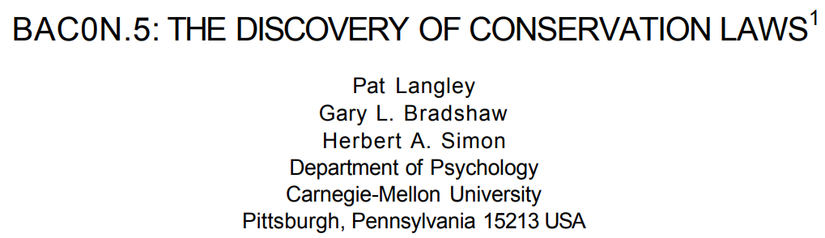
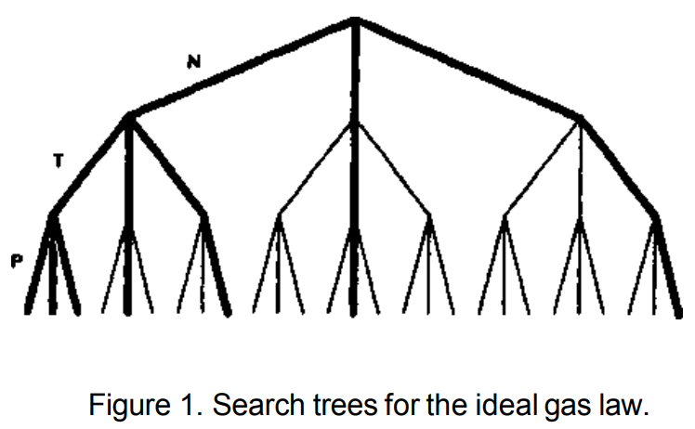
Beginning of Equation Discovery
1979：BACON System 1-5 by Pat Langley
The name "BACON" originates from the British philosopher Francis Bacon, who is regarded as one of the founders of the scientific method.
BACON System marks the beginning of interdisciplinary research between artificial intelligence and scientific discovery.
The BACON system demonstrated the importance of heuristic rules in problem solving—an idea that was later widely applied in many fields, such as optimization problems and expert systems.

Slide 5



What is Equation Discovery？
Equation Discovery is the most fundamental form of scientific discovery. It refers to the process of finding an equation, based on existing background knowledge,
that can accurately explain phenomena in the real world (i.e., experimental data).
🍎
+, ×
h = v×t
v = a×t
m = 0.2 kg
h = 9.8 m
t = 1 s
g = 9.8 m/s²
🌏
$$\&$$
$$h=\frac{1}{2}×g×t^{2}$$
$$⇒$$
find
Equation
BK
Phenomena
Experimental Data
Mainstream approach:
① Symbolic Regression; ② Neural Symbolic; ③ Context Free Grammar
Notes:
公式发现和逻辑推理的关系

Slide 6
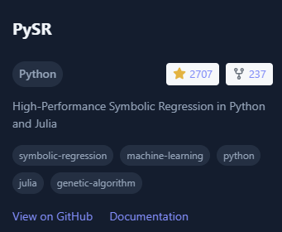
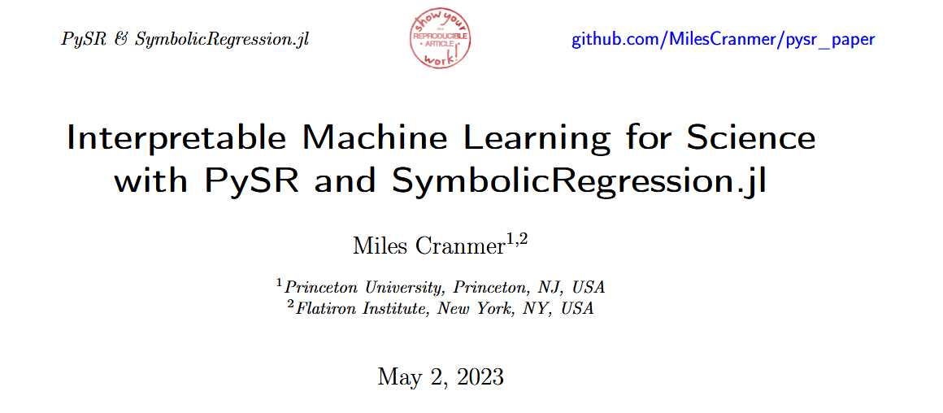
PySR: a Python and Julia package for Scientific Symbolic Regression
PySR’s internal search algorithm is a multi-population evolutionary algorithm, which consists of a unique evolve-simplify-optimize loop, designed for optimization of unknown scalar constants in newly-discovered empirical expressions.

Slide 7
Evolutionary Algorithm
Start
init Population
Calculate fitness
if fit?
Y
Best entity
N
Evolution
Select

Slide 8
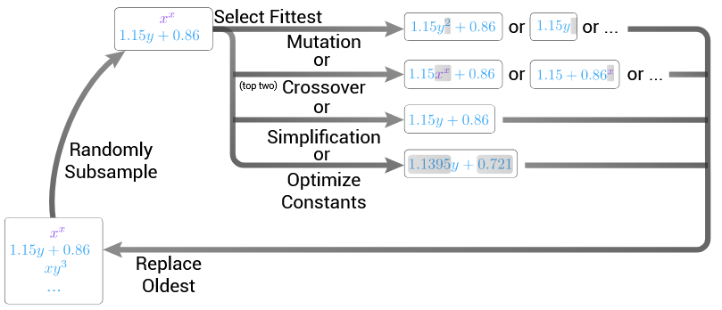
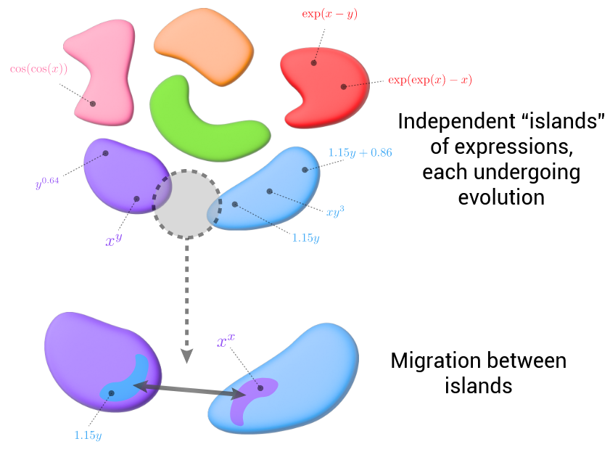
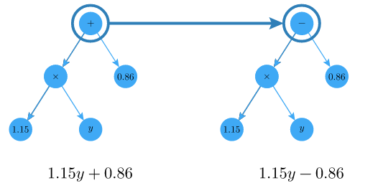
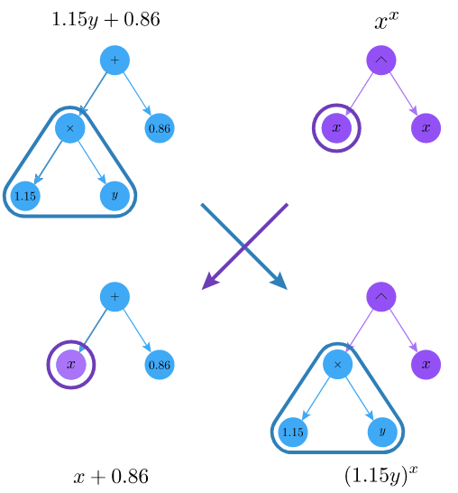
PySR: Evolutionary Algorithm
The inner loop of PySR
mutation
The outer loop of PySR
crossover

Slide 9
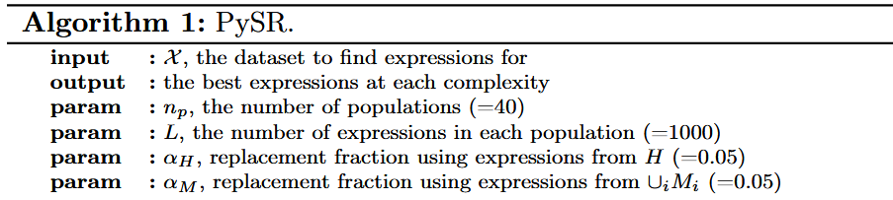
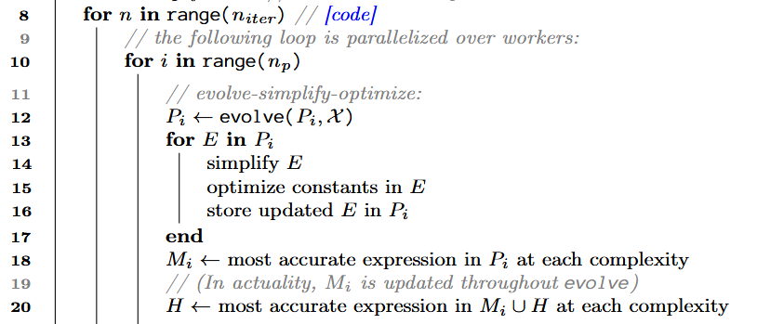
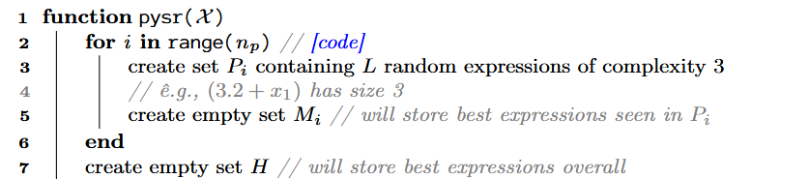
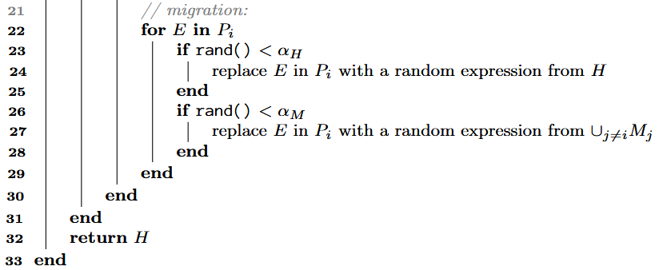
PySR: Algorithm
“embed the genetic algorithm inside an
evolve-simplify-optimize loop”
the Hall of Fame maintains the Pareto frontier of bestperforming equations across all runs
Population Memory preserves diversity by sharing promising solutions between parallel populations.

Slide 10
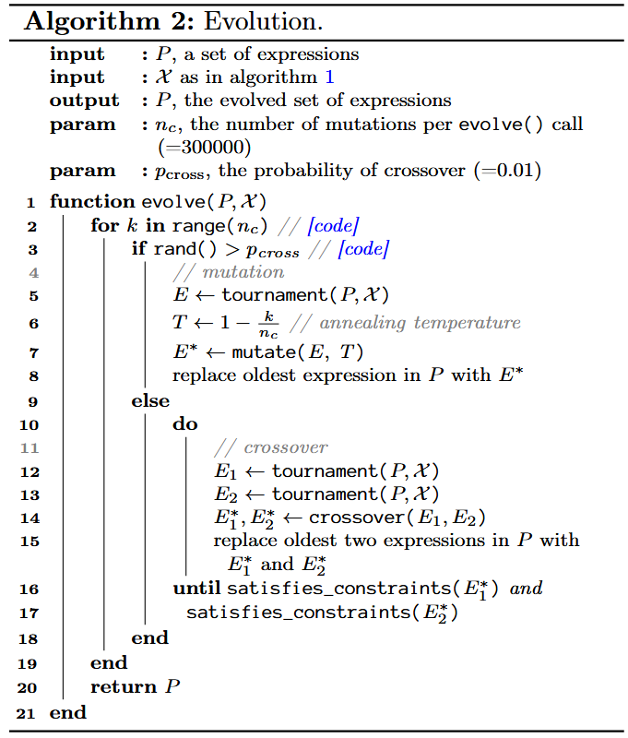
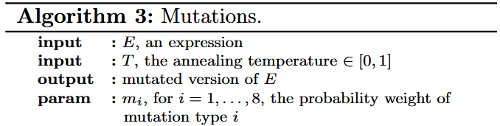
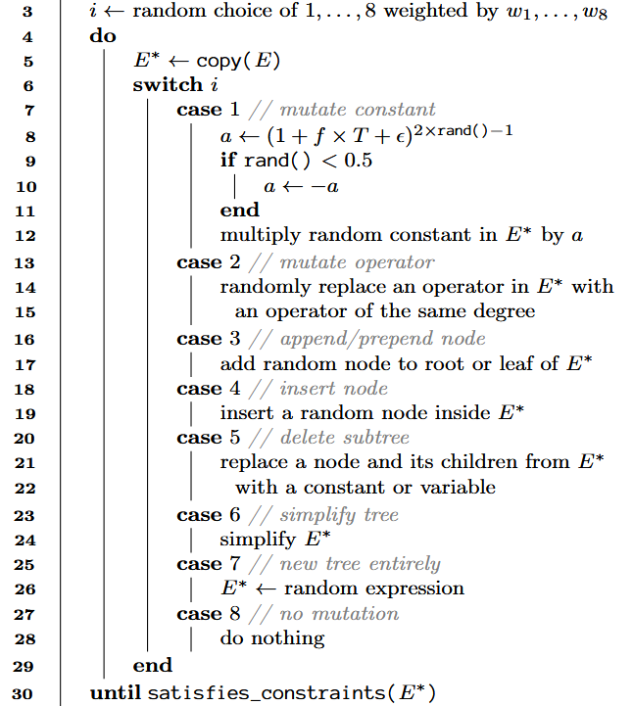
PySR: Algorithm

Slide 11







PySR: Mathematical Interpretation
Feature Space Construction
Complexity Measure Formulation
Search Space Topology
Fitness Function Construction
Population Dynamics
Migration Mechanism
searches for functions:
(evolution follows a Markov chain)

Slide 12
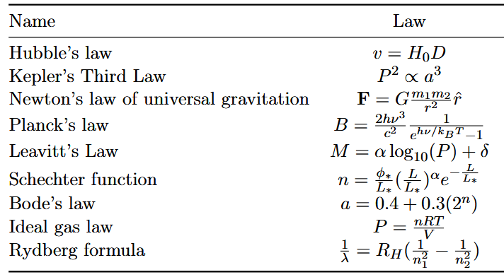
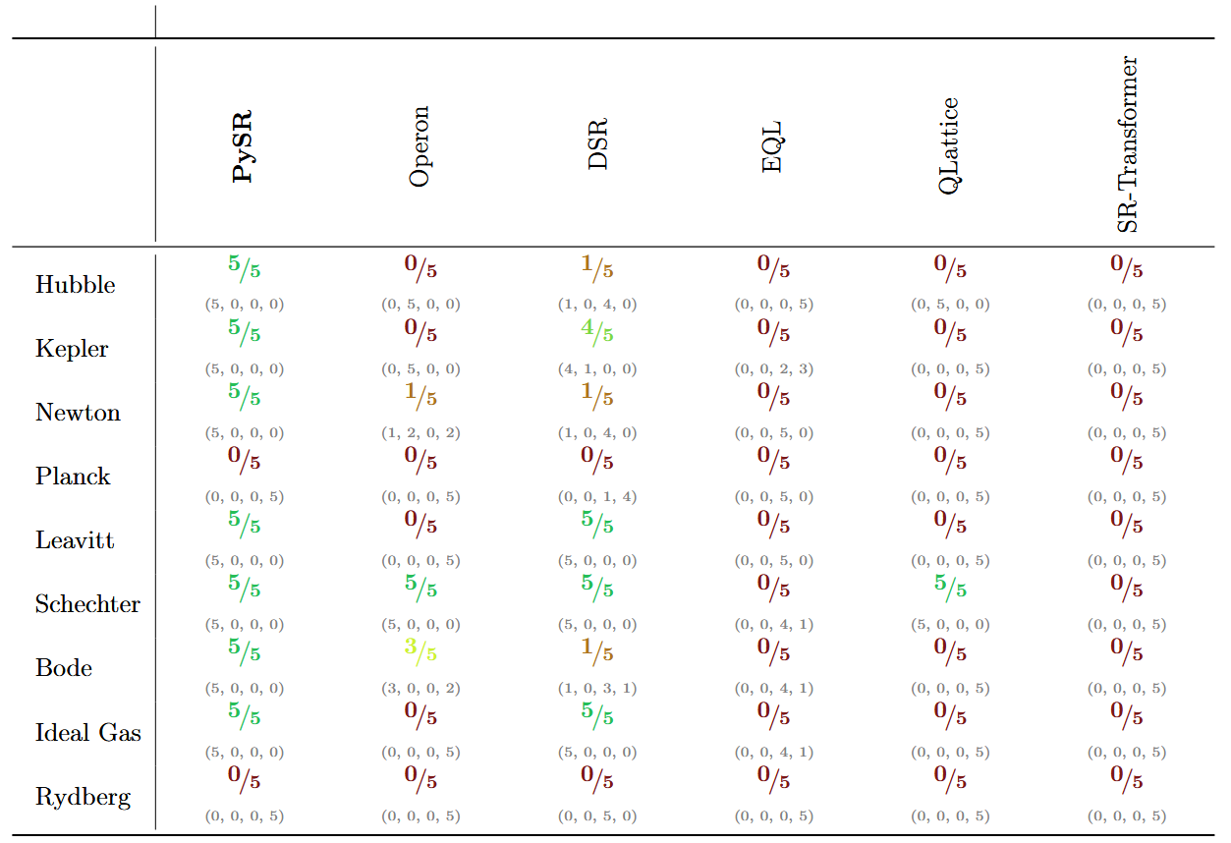
PySR: Evaluation
EmpiricalBench

Slide 13
InceptionSR

Slide 14
InceptionSR: Story
Our work demonstrates that recursive symbolic regression can consistently outperform PySR in terms of both prediction accuracy and equation interpretability. By breaking down complex relationships into simpler, reusable components, InceptionSR makes progress toward automated scientific discovery that yields not just predictive models, but mathematical insights that can inform theory development.

Slide 15
InceptionSR : Differences
There are several key differences between PySR and InceptionSR
PySR is a single-pass learning algorithm where all expressions are discovered in one evolutionary process
InceptionSR is a multi-pass learning algorithm where each pass discovers new relationships using previously discovered patterns.
PySR maintains a fixed feature space during the evolutionary process
InceptionSR has a dynamic feature space that incorporates derived features, successful expressions from prior runs, alongside the original features.
PySR searches through all possible expressions that may be constructed from the original features and operators
InceptionSR uses a hierarchical search space where each subsequent run searches through an augmented space that includes composite functions.
Only a single complexity measure based on expression tree size is used for vanilla PySR
InceptionSR allows for the complexity of input features into PySR to be modified.

Slide 16
InceptionSR: Evolutionary Algorithm
Start
First-generation species
init Population
Evolution
Pareto Frontier
Calculate fitness
Pareto Frontier
Second-generation species
if fit?
Y
Evolution
Library
Best entity
Pareto Frontier
N
Third-generation species
Top k
Evolution
Pareto Frontier
Select
Top k

Slide 17
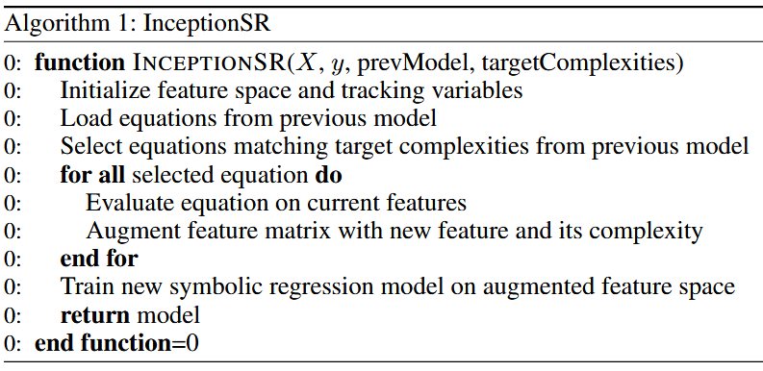
InceptionSR: Algorithm
First-generation species
Evolution
Pareto Frontier
Second-generation species
Evolution
Pareto Frontier
Library
Third-generation species
Top k
Pareto Frontier
Top k

Slide 18





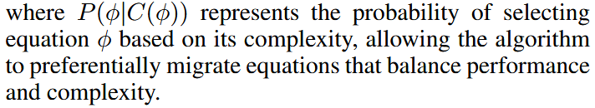
InceptionSR : Mathematical Interpretation
PySR
InceptionSR
Feature Space Construction
Complexity Measure Formulation
Search Space Topology
Fitness Function Construction
Population Dynamics
Migration Mechanism
searches for functions:
(evolution follows a Markov chain)

Slide 19
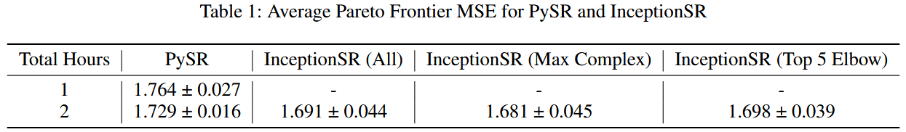
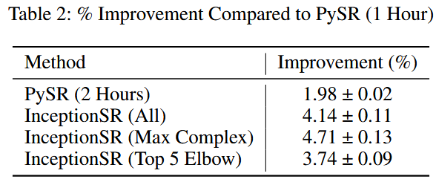
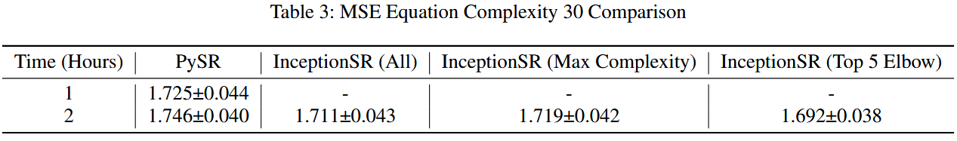
InceptionSR: Results

Slide 20
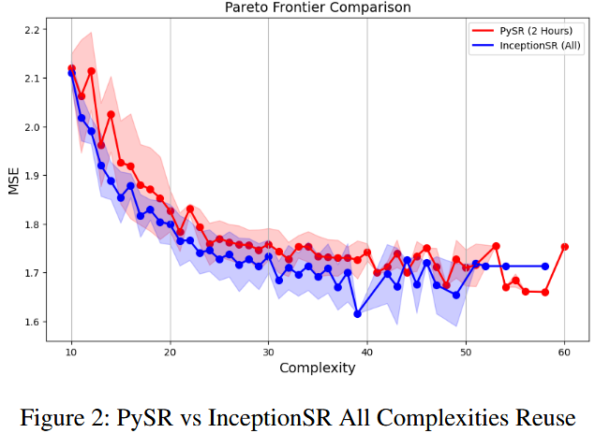
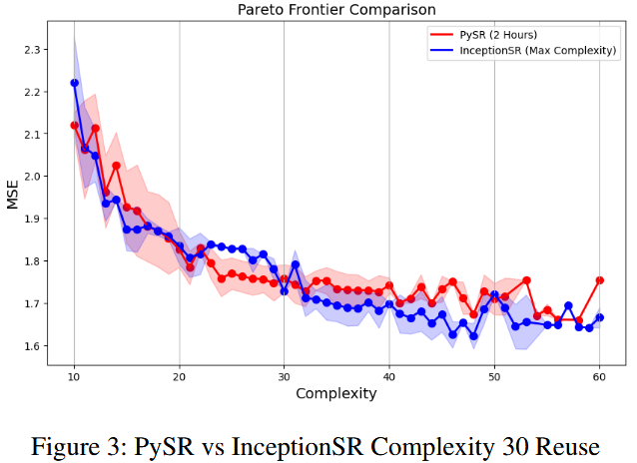
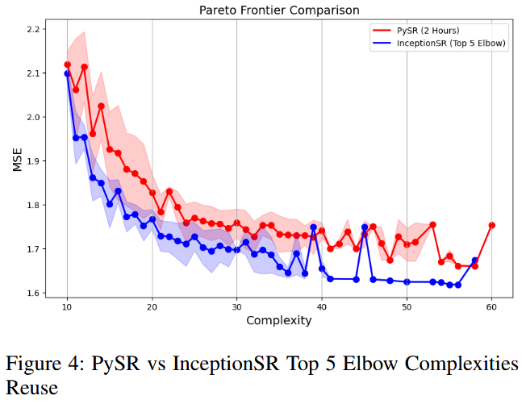
InceptionSR: Results

Slide 21
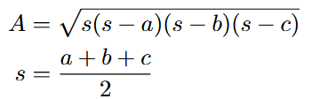

Heron’s Formula Rediscovery
Running PySR for multiple hours was unsuccessful in discovering a subexpression close to s.
Directly running PySR for 1 hour produces equations that contain a + b + c as a component in the overall equation.
Etracting the feature −a−b−c to reuse as s.
Subsequently, the second iteration of PySR (1 hour) recognized the importance of s and reused it three times in all equations on the Pareto frontier after complexity 20.
Here is one such equation synthesized (coefficients removed):

Slide 22
Summary
It is not sufficient to evaluate solely based on the current equation's fit to the target data.
Grammar-based methods are more capable of generating complex formulas.
Evolutionary algorithm-based approaches have advantages in fine-tuning.
Evolutionary algorithm-based approaches are hard to trace
*
+
x
y
c
*
+
x
x
y
c
+
*
+
x
x
y
c
Evolutionary algorithm-based
Grammar-based methods

